Slide 1

Fighting Fraud the 49er Way
Cyndi Autenrieth, Senior Auditor
Diana Hill, Staff Auditor
April 5, 2023

Slide 2

Housekeeping
Sign in on the sign in sheet
Bathrooms are out the door straight ahead
In case of emergency/evacuation, exit via door in room or out the front door
Please feel free to ask questions anytime throughout the presentation
Please log in to Learning and Development to complete an evaluation

Slide 3
Today’s Objectives
Review definitions
Describe the 3 types of occupational fraud
Discuss fraud prevention and detection
Examples of higher education fraud
Learn how you can help

Slide 4
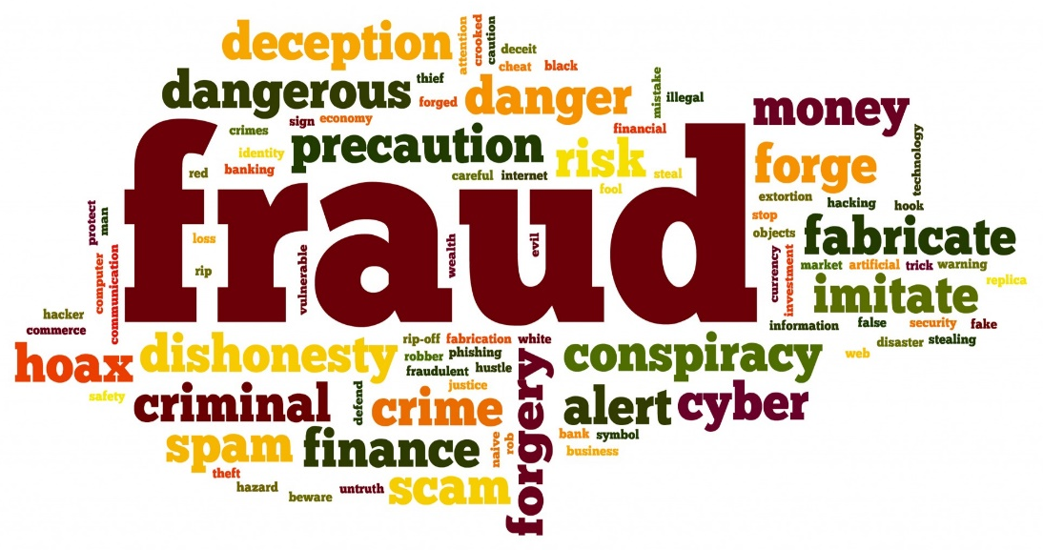
What is Fraud?

Slide 5
An intentional or deliberate act to deprive another of property or money by guile, deception, or other unfair means

Slide 6
The Cost of Fraud
How much is the average cost of fraud?
5% of annual revenue
How much is that to the University?
$40.7 million
Based Upon Total FY2022 Operating and Non-Operating Revenue of UNC Charlotte

Slide 7


What does 5% look like?
5% of Salaries and Benefits (FY2022)
$19.5 Millions
5% of time, Total 2080 hours
104 hours or 13 days per year per employee
Based Upon Total FY2022 Total Salaries and Benefits of UNC Charlotte

Slide 8
Whodunnit
Whodunnit?
Notes:
Relink

Slide 9
Categories of Fraud
Against Individuals
Identify Theft, Phishing Scams, Advance Fee Schemes, Ponzi Schemes
Internal organizational Fraud
“Occupational Fraud”
Embezzlement, Falsifying Records, Lying to Stakeholders
External Organizational Fraud
Vendor Fraud, Bribes, Bad Checks, Stolen Intellectual Property or Customer Information Theft

Slide 10

Our Focus
Occupational Fraud – using one’s job for personal enrichment by intentionally misusing or misapplying their employer’s resources or assets.
Also known as white collar crime

Slide 11
Common Examples
Expense reimbursement – claiming an expense more than once/claiming a fake expense
Payroll – falsifying time records with time not worked/not entering leave taken
Bribes/Kickbacks – receiving gifts or money from a vendor
Inappropriate and/or fictitious charges on research studies

Slide 12
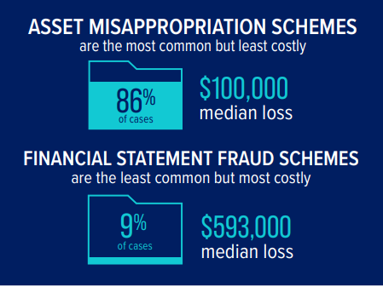
Types of Occupational Fraud
Asset Misappropriation (most common)
Corruption
Financial Statement Fraud (most costly)
Notes:
2022 ACFE Report to the Nation

Slide 13






Asset Misappropriation
Notes:
Misappropriation of Assets: theft or misuse of University assets
1. Theft of Cash – Skimming, Cash Larceny
2. Fraudulent Disbursements - Check tampering
Billing Schemes
Expense Reimbursements
3. Theft of Intellectual Property such as trade secrets or copyrights

Slide 14
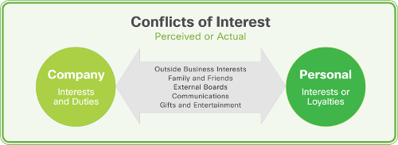


Corruption
Notes:
Corruption: abusing influence and power within the University to obtain some benefit at the University’s expense
1 . Conflicts of Interest - Occurs when someone has an undisclosed economic or personal interest in a transaction that adversely affects that person’s employer .
2. Bribery – employee getting a kickback from a contractor
3. Manager that doesn’t have access to perform a function (request a check) and uses influence over employee (threatens bad performance review or termination) to get the employee to do it for them

Slide 15

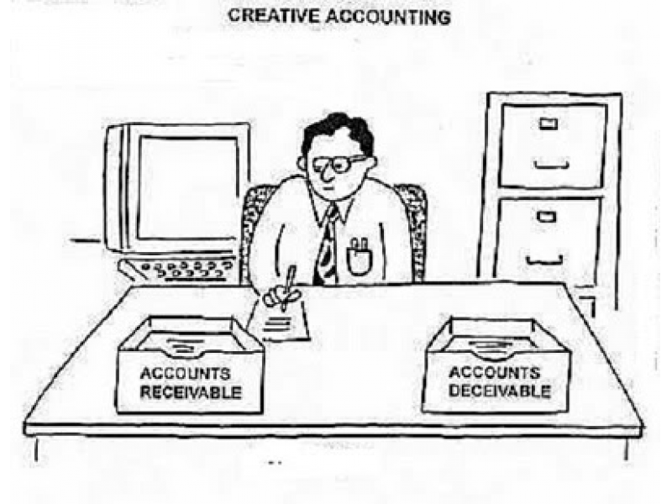

Financial Statement Fraud
Notes:
Financial Statement Fraud: intentional misstatements or omissions of amounts or disclosures in financial statements
(e.g. recording fictitious revenues, understating expenses or artificially inflating reported assets)

Slide 16

Test Your Knowledge

Slide 17
Question
Question 1a: What is the most common type of occupational fraud?
a. asset misappropriation
b. corruption
c. financial statement fraud

Slide 18
Answer
Question 1a: What is the most common type of occupational fraud?
a. asset misappropriation
b. corruption
c. financial statement fraud

Slide 19
Question
Question 1b: What is asset misappropriation?
a. incorrect choice of account codes for assets
b. theft or misuse of University assets
c. using University equipment for personal reasons
d. both b and c

Slide 20
Answer
Question 1b: What is asset misappropriation?
a. incorrect choice of account codes for assets
b. theft or misuse of University assets
c. using University equipment for personal reasons
d. both b and c

Slide 21
Question
Question 1c: True or False: It is estimated that fraud in a typical organization is approximately 2% of annual revenue.
True
b. False

Slide 22
Answer
Question 1c: True or False: It is estimated that fraud in a typical organization is approximately 2% of annual revenue.
True
b. False

Slide 23
Fraud Facts
Note: The Association of Certified Fraud Examiners – 2022 Reports to the Nation are the sources of the charts and graphs for 2110 Fraud Cases in this section of the presentation unless stated otherwise
Notes:
Reports to the Nation can be found at acfe.com.

Slide 24
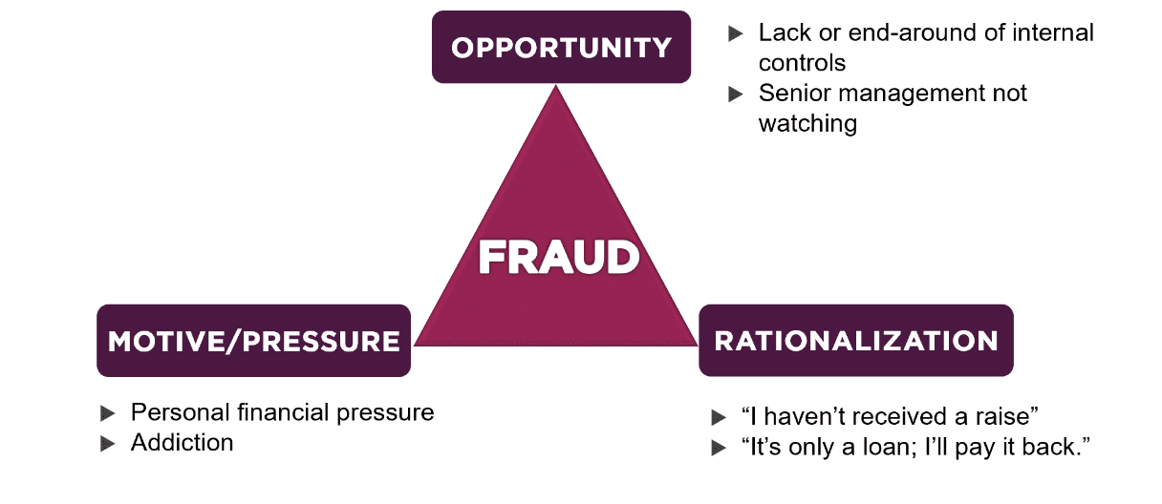
How & Why Fraud Occurs
FRAUD
Source: Anders CPAs & Advisors
Notes:
#1 weakness
Fraud occurs due to a lack of internal controls

Slide 25
Video
Fraud Triangle

Slide 26


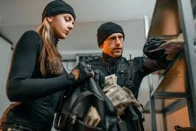

Who Commits Fraud
FRAUD
Notes:
#1 weakness
Fraud occurs due to a lack of internal controls

Slide 27
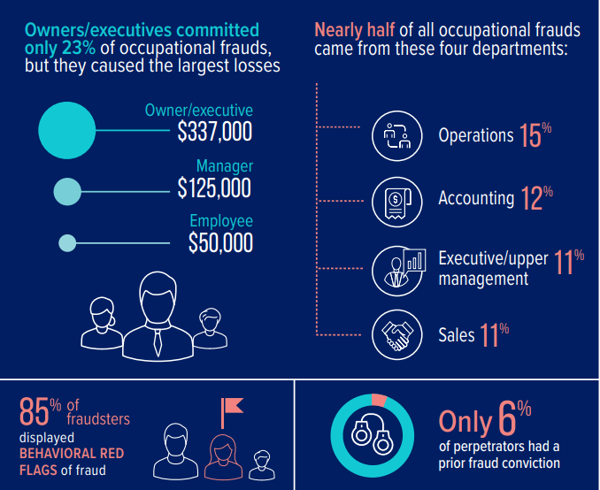
Using 2110 Cases of Fraud
Notes:
2110 cases
65% of the perpetrators had a university degree or higher
3% of fraudsters were over 60 but older fraudsters caused much larger median losses

Slide 28
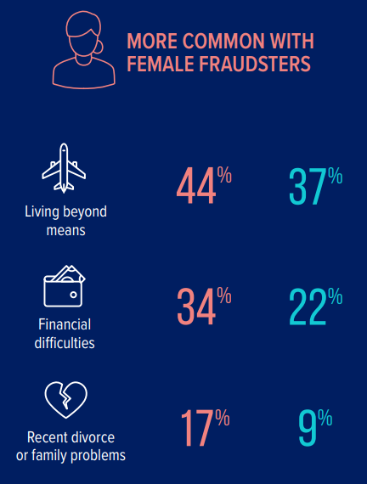
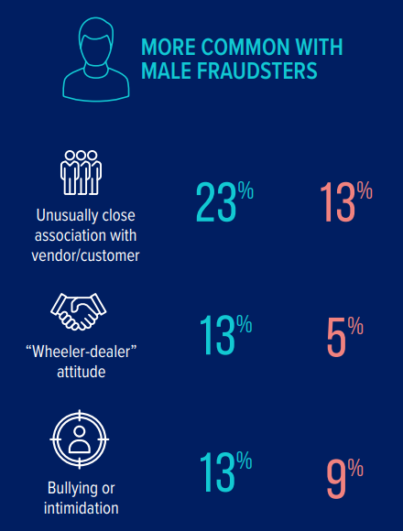

Fraud by Gender
Notes:
72% of cases had male perpetrators

Slide 29
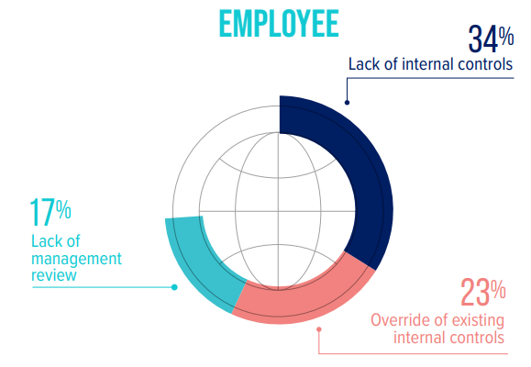
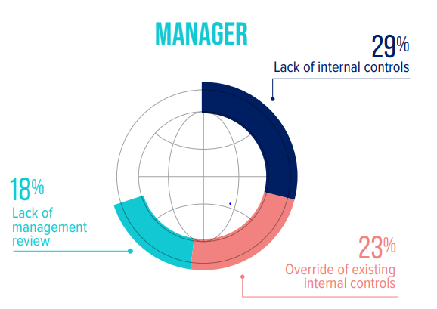
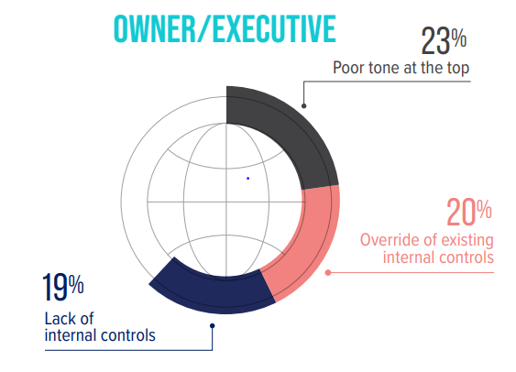
Fraud by Position
Notes:
Top 3 Internal Control Weaknesses Based on the Perpetrator’s Position

Slide 30
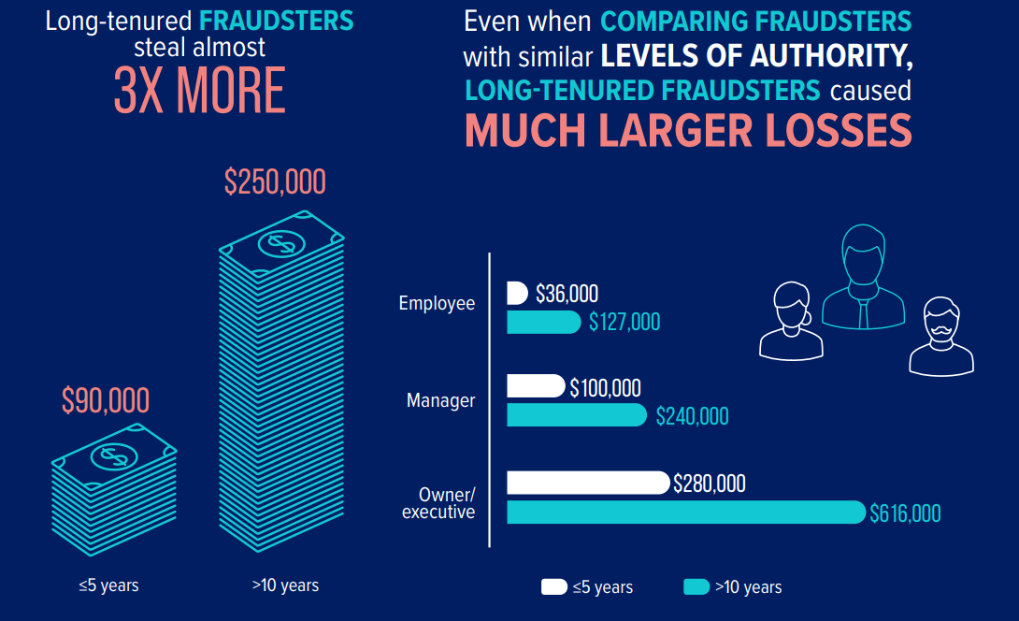
Tenure of Perpetrator
Notes:
The longer a person works for a company, the better they become at fraud.

Slide 31
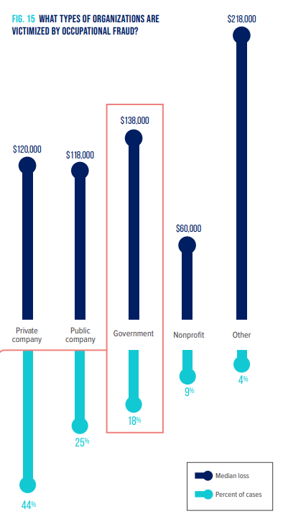
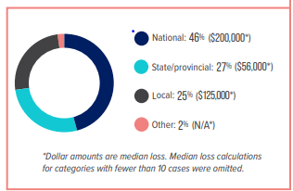
Breakdown by Industry

Slide 32
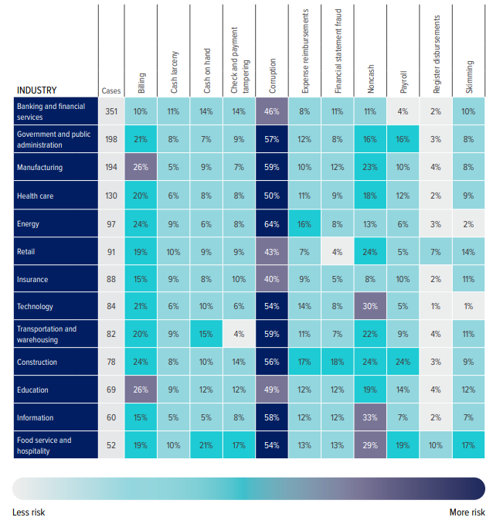
Schemes by Industry

Slide 33
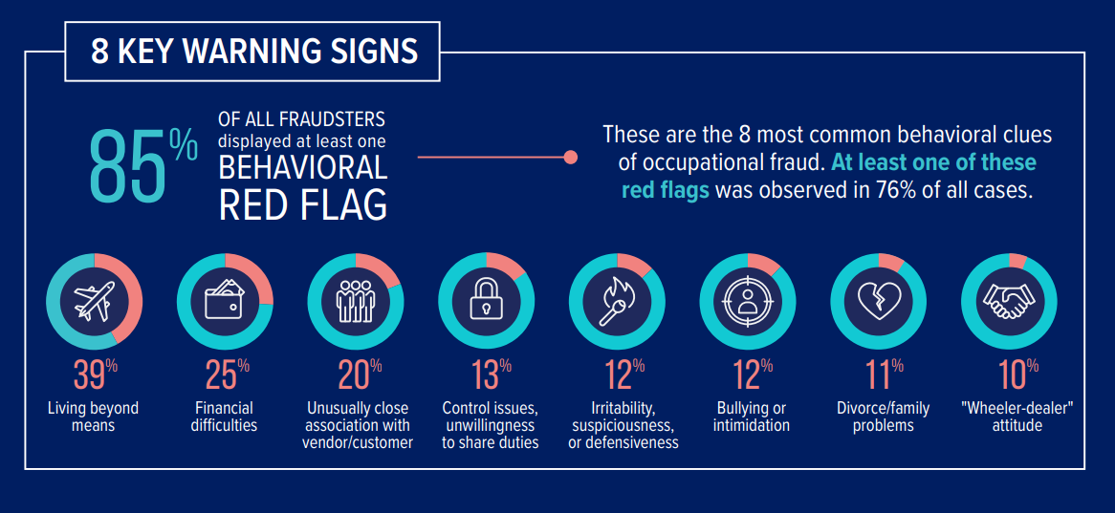
Common Perpetrator Behaviors
Notes:
Red Flags are behaviors or characteristics that serve as a sign that a fraud is occurring.
Fraudsters living beyond their means has been the most common red flag per every The Association of Certified Fraud Examiners - Reports to the Nation study since 2008.

Slide 34
Test Your Knowledge

Slide 35
Question
Question 2a: Which is not a component of the fraud triangle?
a. opportunity
b. pressure
c. embezzlement
d. rationalization

Slide 36
Answer
Question 2a: Which is not a component of the fraud triangle?
a. opportunity
b. pressure
c. embezzlement
d. rationalization

Slide 37
Question
Question 2b: What are red flags?
a. behaviors or characteristics that serve as a sign fraud is occurring
b. part of the fraud triangle
c. what shows up on a background check if someone has a criminal record

Slide 38
Answer
Question 2b: What are red flags?
a. behaviors or characteristics that serve as a sign fraud is occurring
b. part of the fraud triangle
c. what shows up on a background check if someone has a criminal record

Slide 39
Question
Question 2c: What is the most common red flag displayed by someone committing fraud?
altered documents
b. living beyond one’s means/change in lifestyle
c. excessive absenteeism

Slide 40
Answer
Question 2c: What is the most common red flag displayed by someone committing fraud?
altered documents
b. living beyond one’s means/change in lifestyle
c. excessive absenteeism

Slide 41
Fraud Prevention & Detection

Slide 42
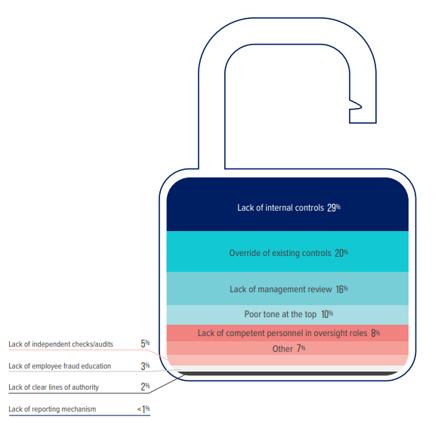
Internal Control Weaknesses
Notes:
Internal Control Weaknesses that contribute to fraud:
Lack of internal controls-29%
Override of existing controls-20%
Lack of management review-16%
The top 3 total 65%

Slide 43
Preventing Fraud
Review of Internal Controls
-Proper Segregation of Duties
-Use of Authorizations, Approvals and Verifications
-Physical Safeguards
-Control over Assets
Mandatory Vacations
Fraud and Ethics Training
Reporting Mechanism
Honest and Integrity – Tone at the Top
Fraud Risk Assessment
Support Employee Programs

Slide 44
Detecting Fraud
Monitoring
Employee Tips
Detection By Accident
Internal Audit, IT and Risk Functions
Forensic Data Analytics (Software)
Audit and Monitor for Fraud Threats Consistently
Once fraud detection and prevention methods are in place, continue auditing and monitoring for threats.

Slide 45
In The News: Yale University
Facts
Jamie Petrone-Codrington, Lead Administrator, Yale School of Medicine’s Department of Emergency Medicine
Theft of $40 million of purchased computer and hardware and resold it to out of state resellers for personal gain over a decade ($25.5 million of the $40 million was stolen in the last 3 years of the fraud)
Stayed below the Fixed Asset $10,000 threshold and would provide false justification and doctor emails
Wired proceeds to a company that she was a principal owner
Spent $20 million of the proceeds: $4 million on travel, $4 million spent on entertainment and $2.5 million spent on retail
On her tax return for 4 years, she wrote off the stolen equipment as business expenses and didn’t file a returns for 4 years
Yale had alerted authorities
Since the incident, Yale has worked to identify and correct gaps in its internal financial controls

Slide 46
In The News: Yale University
Outcome
Arrested in September 2021, As part of a plea deal, Petrone-Codrington pled guilty to wire fraud and filing a false tax return, sentenced to 9 years in prison in October 2022 with 3 years supervised release, she was ordered to pay restitution
Petrone-Codrington agreed to forfeit $560,421.14 from the company bank account, in addition to six luxury cars: a 2014 Mercedes-Benz G550, a 2017 Land Rover/Range Rover SVAutobiography, a 2015 Cadillac Escalade Premium, a 2020 Mercedes Benz Model E450A, a 2016 Cadillac Escalade (4 Door Sport) and a 2018 Dodge Charger, she also agreed to liquidate three Connecticut properties pursuant to her restitution obligation and a property she owns in Georgia will also be subject to seizure and liquidation

Slide 47
In The News: J. Sargeant Reynolds Community College
Facts
Kiesha Pope, Director of Financial Aid
Theft of at least $230,000 in Student Financial Aid Funds/grant funds from 2006-2017, could be as high as $398,000
Manufactured or boosted financial aid eligibility for individuals, often her family members, who were not in fact eligible for financial aid
Pope fraudulently overrode Reynolds' internal automated controls to manually place her co-conspirators in a status that guaranteed their continued receipt of financial aid funds (son, ex-fiancé, daughter, goddaughter, cousin)
Directed 4 co-conspirators to send the majority of financial funds to her
Spent funds on personal expenses, vacations, retail shopping and expenses for her daughter
In 2017, the college confronted Pope about her relationships with various academically ineligible students receiving financial aid, she alleged the students had supporting documentation
When pressed by the College, she resigned
In a press release, Reynolds stated Leadership of the Financial Aid and college leaders responsible for its oversight during the time period are no longer employed by the College
New leadership has worked diligently to ensure the integrity of all aspects of the financial aid operations

Slide 48
In The News: J. Sargeant Reynolds Community College
Outcome
Pope resigned, she was charged with conspiring to commit wire fraud, wire fraud and aggravated identify theft
The President testified at the trial and Pope’s crimes had damaged the reputation of the College, demoralized the financial aid staff and most likely cost the College some philanthropic investments
Sentenced to 5 years in prison and restitution of $230,000

Slide 49
Why are Universities susceptible to fraud?
Budget cuts create little or no segregation of duties
Long tenures
Lower overall salaries in education
Policies/procedures are not communicated
No anti-fraud training
Reporting structure is siloed
Low risk of detection
Low risk of prosecution
People don’t realized there could be a problem

Slide 50
How can you help?

Slide 51
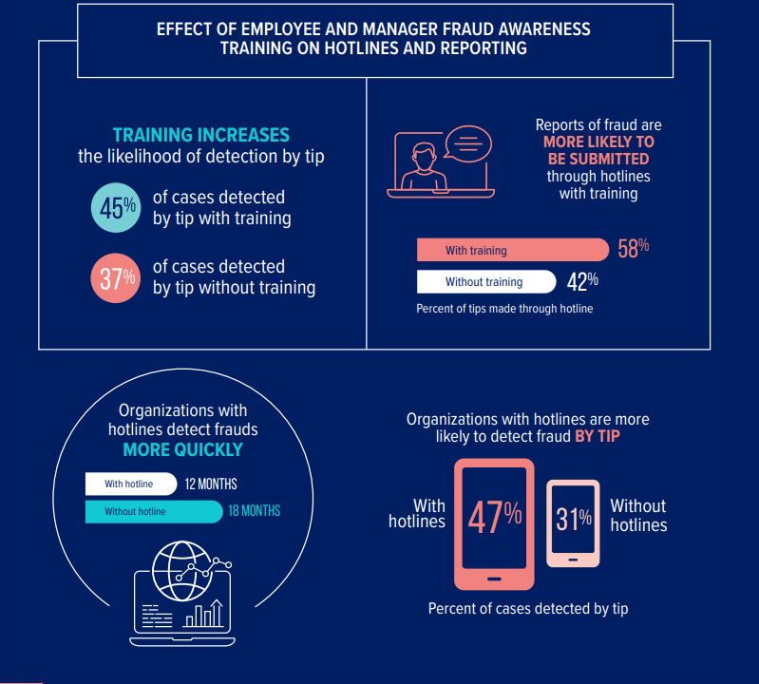
Notes:
Training, hotlines, tips

Slide 52
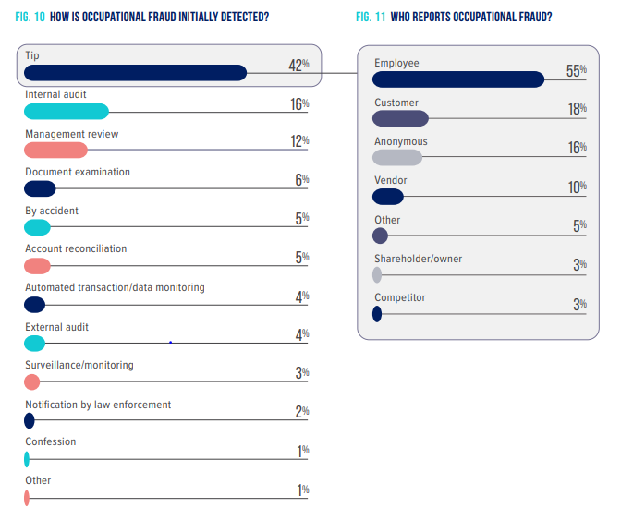
Fraud Detection
Notes:
The number one fraud identifier are tips. The majority are reported by employees.

Slide 53
Duty to Report
State law requires that you report fraud and the law protects you from retaliation. (§126-84;126-85)
Standards of Conduct – UP 804
Whistleblower Protection – UP 803
Notes:
Under NC law and University policy, State employees have a responsibility to report:
Violations of State or federal law, rules, or regulations
Suspected fraud including misappropriation of State resources
Substantial and specific danger to public health and safety
Gross mismanagement, waste of monies, or gross abuse of authority
If you witness a crime call campus police at EXT 7-2200, emergency and EXT 7-8300, non-emergency
Under NC law and University policy #803 whistleblowers have protection from retaliation
4. University policy #804 Standards of Ethical Conduct describes our responsibilities as University employees

Slide 54
Options for Reporting Fraud
Supervisor
Internal Audit
  (704) 687-5693
University’s third party anonymous hotline
      (844) 251-1873 or https://secure.ethicspoint.com/domain/media/en/gui/43118/index.html
Office of the State Auditor (also anonymous)
    (800) 730-TIPS (8477)
    (If you see a crime, contact the police.)
Notes:
Check the numbers

Slide 55
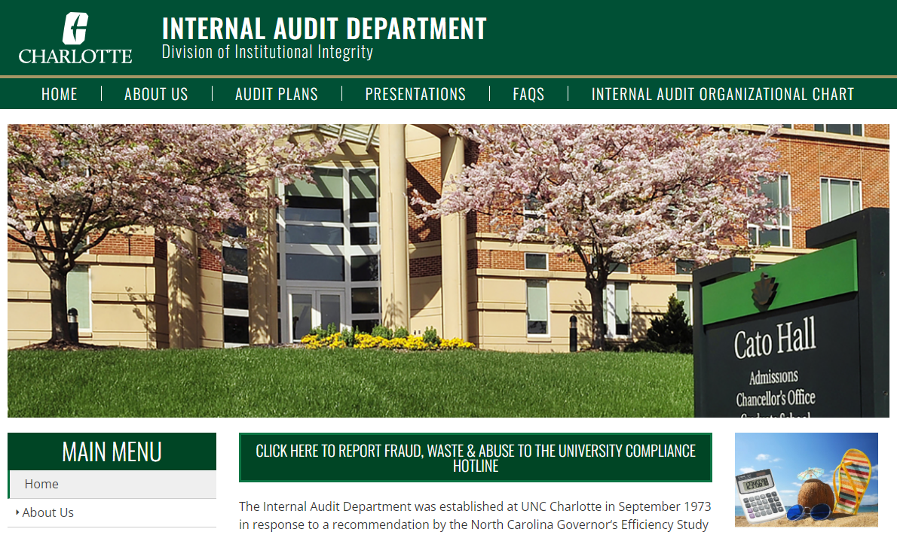
Internal Audit
Hotline link

Slide 56
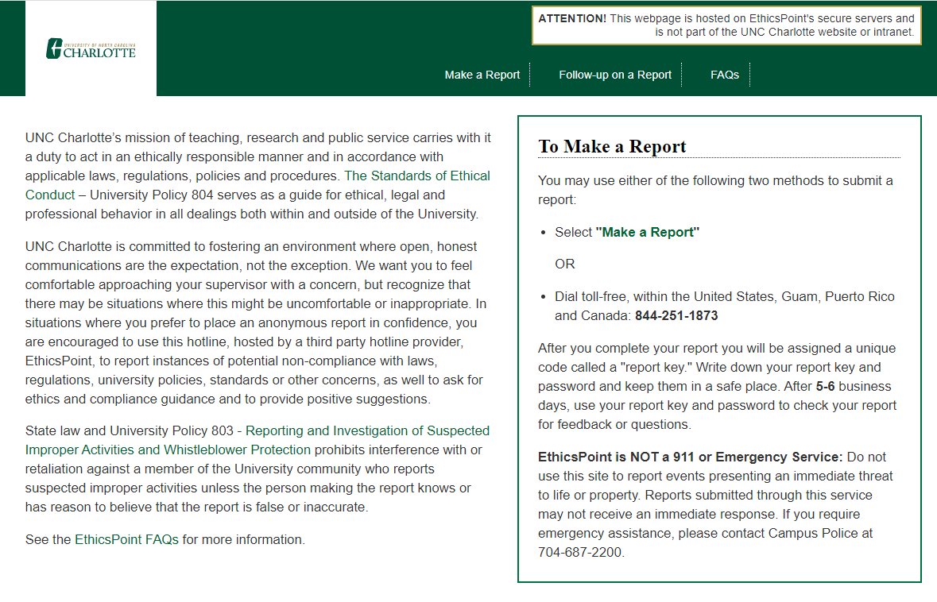
EthicsPoint
Hotline

Slide 57
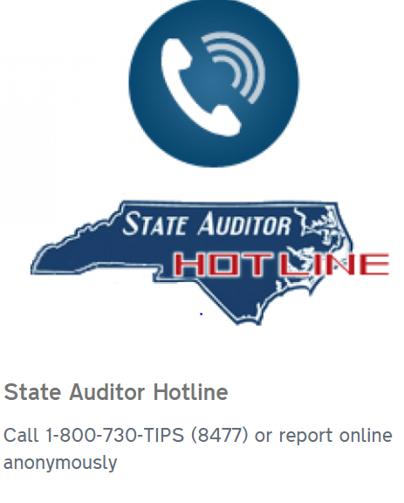
Office of the State Auditor

Slide 58
Test Your Knowledge

Slide 59
Question
Question 3a: What is the #1 weakness that allows fraud to occur?
a. not enough staff
b. lack of internal controls
c. poor tone at the top

Slide 60
Answer
Question 3a: What is the #1 weakness that allows fraud to occur?
a. not enough staff
b. lack of internal controls
c. poor tone at the top

Slide 61
Question
Question 3b: Which of the following is an internal control?
a. segregation of duties
b. authorization and approval
c. asset inventory
d. all of the above

Slide 62
Answer
Question 3b: Which of the following is an internal control?
a. segregation of duties
b. authorization and approval
c. asset inventory
d. all of the above

Slide 63
Question
Question 3c: Who has a responsibility to report suspected fraud, waste, and abuse?
a. all employees
b. supervisors
c. Vice Chancellors

Slide 64
Answer
Question 3c: Who has a responsibility to report suspected fraud, waste, and abuse?
a. all employees
b. supervisors
c. Vice Chancellors

Slide 65
Recap
Definition of fraud
Three types of occupational fraud
Fraud prevention and detection
Monitor
How you can help

Slide 66
Resources
ACFE Occupational Fraud 2022: A Report to the Nations
Detecting and Preventing Fraud in Higher Education
Fraud 101: What Is Fraud?
Rita Crundwell – Fraud in Dixon, IL (13 Minutes)
The Madoff Affair – PBS (55 minutes)

Slide 67


Slide 68
Contact Information
Cyndi Autenrieth, Senior Auditor
cautenri@uncc.edu
704-687-0049
Diana Hill, Staff Auditor
DianaHill@uncc.edu
704-687-5695

