Slide 1


Internal Auditing - What’s It All About?
Kevin Vehar, Audit Manager Monique Emery, Staff Auditor April 6, 2023

Slide 2

Housekeeping
Please “mute” the audio on your device.
Please feel free to ask questions anytime throughout the presentation.

Slide 3

Today’s Objectives
What is Internal Audit?
What are Risks?
Defining Internal controls
What can I do to prepare myself for an audit?

Slide 4

What is Internal Audit?
Internal Auditing is an independent, objective assurance and consulting activity designed to add value and improve an organization’s operations. It helps an organization accomplish its objectives by bringing a systematic, disciplined approach to evaluate and improve the effectiveness of risk management, control, and governance processes.

Slide 5

To enhance and protect organizational value by providing risk-based and objective assurance, advice, and insight.

Slide 6

Vision
To be a respected campus partner whose advice is sought and whose integrity is beyond reproach.
with a highly skilled and professionally credentialed staff.
to provide unbiased evaluations with actionable recommendations.
continuously seek to improve internal operations and service delivery through quantitative and qualitative evaluations and measurements.

Slide 7

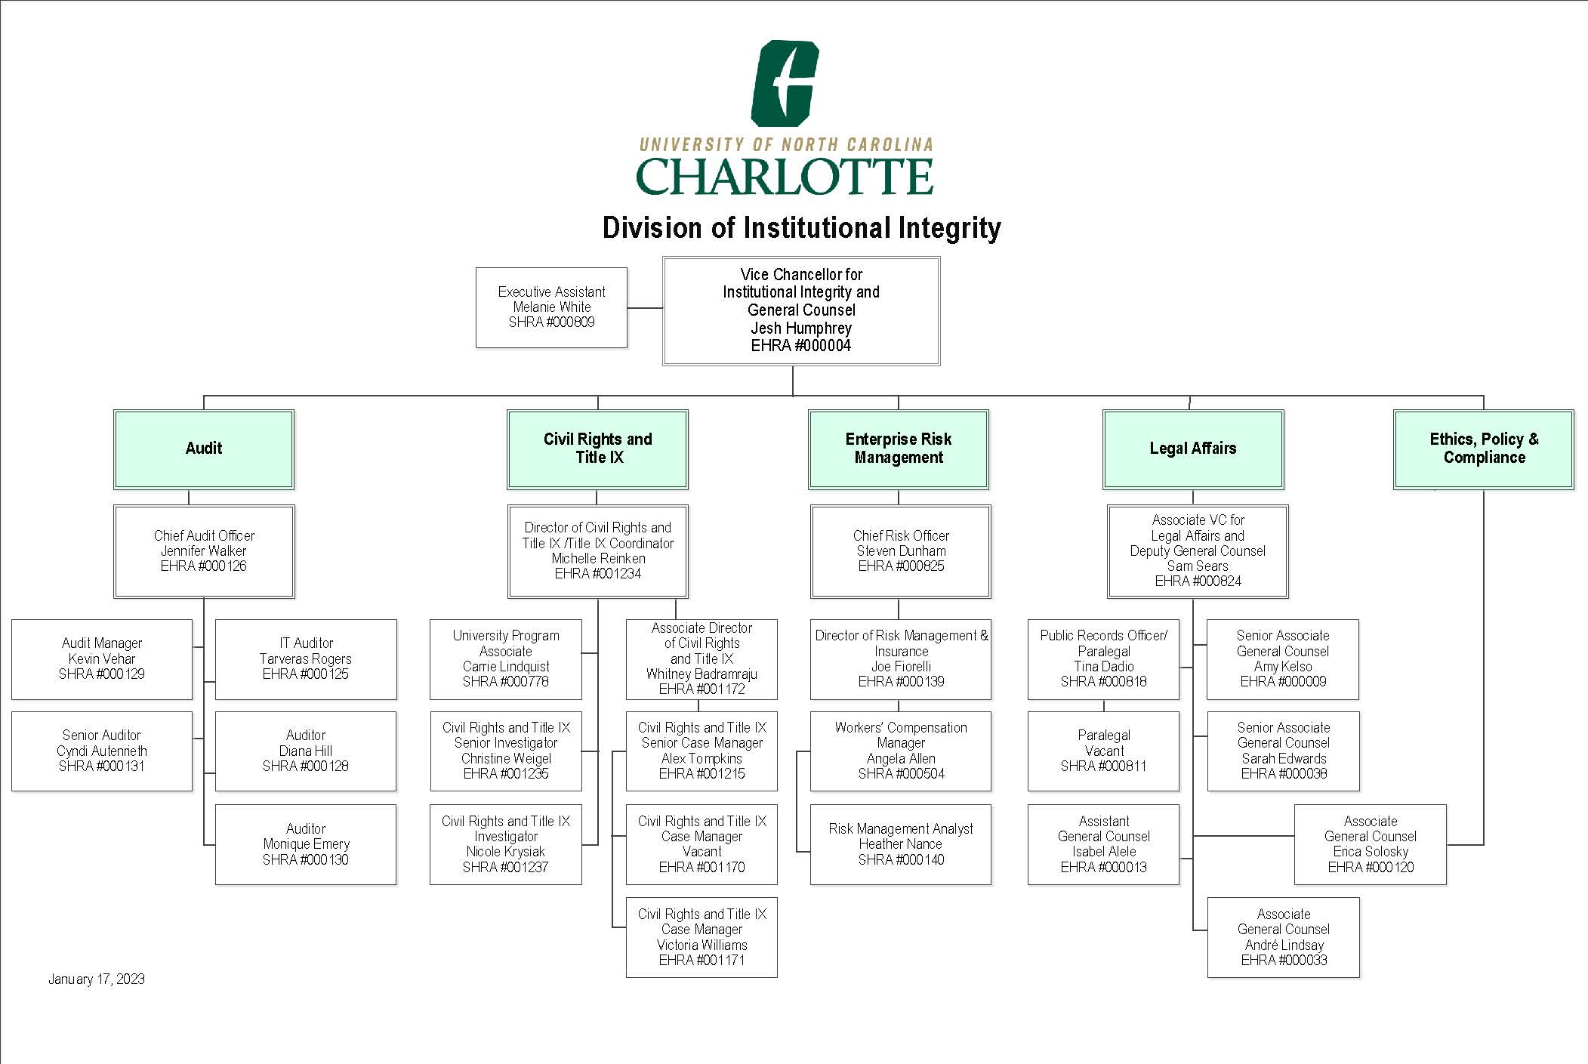

Slide 8

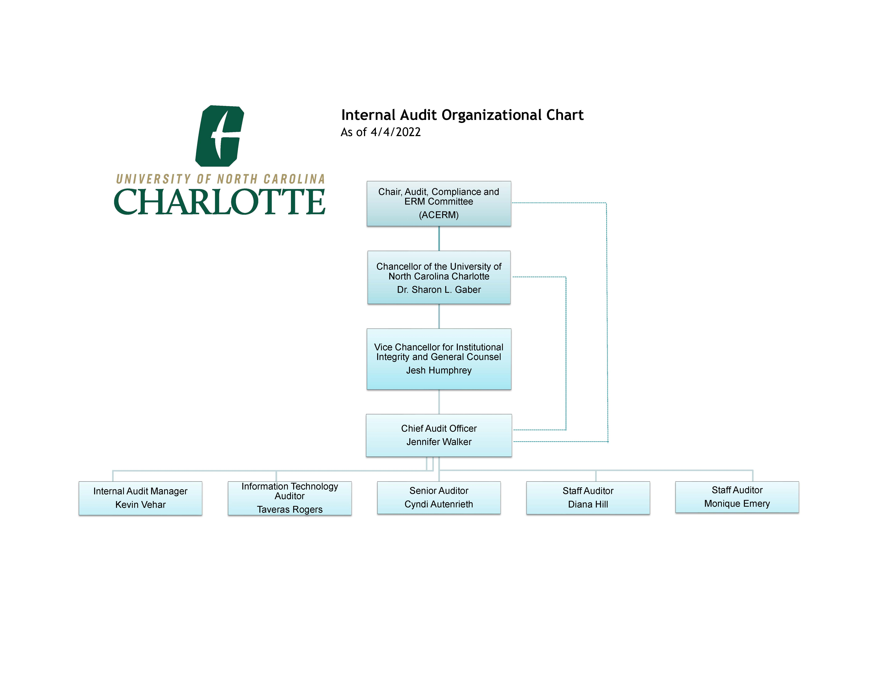

Slide 9

Components that Contribute to the Audit Plan Development
Feedback from members of the ACERM Committee.
Feedback from the Chancellor and members of the Cabinet.
Time since the last audit.
Number of findings in the last audit.
Dollar-value of transactions processed through the area.
Complexity.
Changes in policies, rules or regulations.
New system development.
Changes in key personnel.

Slide 10

FY23’ Audit Plan

Slide 11

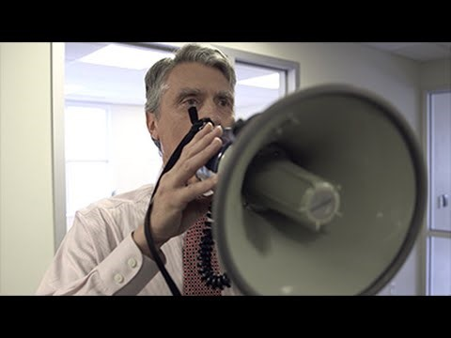
VIDEO- Myths, Fears & Truth about Internal Audit:
https://www.youtube.com/watch?v=gZUAdpQfwHo

Slide 12
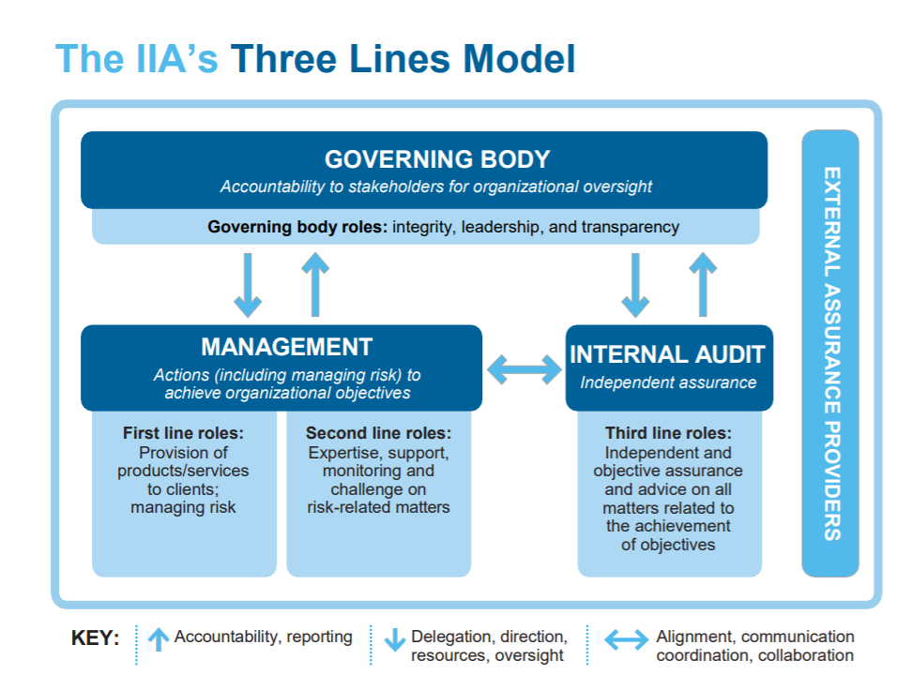

Slide 13

Typical First Line Roles
College Business Officers
Business Support Specialists
Supervisors, Managers, and Directors

Slide 14
Second Line: Risk and Compliance
Compliance Functions (Research, Athletics, etc.)
Police and Public Safety
Environmental Health & Safety
IT Security
Controller’s Office Compliance Team
Director of Ethics, Policy and Compliance – Erica Solosky
Chief Risk Officer – Steven Dunham

Slide 15
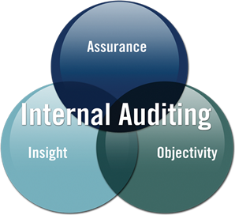
Third Line: Internal Audit

Slide 16
What are Risks?

Slide 17
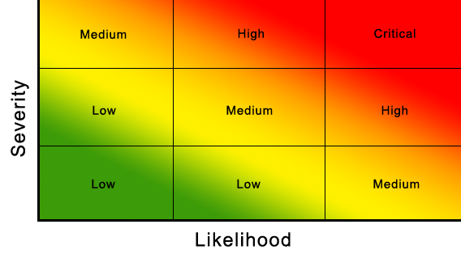
Risk Assessment
What could go wrong in your department?
What is the chance of it happening? (Likelihood)
How big of a deal is it? (Severity/Impact)

Slide 18
Internal Controls
Internal controls are the tasks that are in place to help address risks.
What can go wrong? → Risk
What can we do to reduce the risk? → Control
One risk could have multiple controls.
One control could mitigate multiple risks.

Slide 19
What are Internal Controls?
Internal controls are steps within a process designed to provide reasonable assurance regarding the achievement of control objectives relating to:
Effectiveness and Efficiency of Operations
Reliability of Financial Reporting
Compliance with Applicable Laws, Regulations, Policies & Procedures

Slide 20
Effectiveness and Efficiency of Operations
How can the job be completed to the intended result in an easier, faster way?
How can the job be done with accurate results?
How can the unit reach maximum productivity using minimal resources?

Slide 21
Reliability of Financial Reporting
University Policy 601.8 – Appropriate Use of University Funds:
  State funds (appropriated funds)
  Foundation funds
  Discretionary funds
Grant funds – Research Administration Policies

Slide 22
Compliance with Applicable Laws, Regulations, Policies & Procedures
Federal laws – FERPA, Title IX
State laws – Department of Labor, Daily Deposit Act, Ethics & Compliance laws
County/city laws – waste disposal, code enforcement
UNC System policies – personnel, tuition, academic programs
UNC Charlotte policies – legal.uncc.edu
IT Standards and guidelines – itservices.uncc.edu

Slide 23
Types of Internal Controls
Preventive:
  Training on policies
  Assigning user access rights
  Automatic log-off after period of inactivity
  Segregation of duties

Slide 24
Types of Internal Controls
Detective:
  Comparison of received goods to purchase order
  Reconciliations of Banner to internal records
  Supervisor review

Slide 25
What are some of the internal controls that you encounter every day?
Computer username and password
Preset time-out on screensaver
Card swipe door locks
Reconciliations
Document reviews

Slide 26
Internal Control
Process Step
The department admin prepares reports
The office submits reimbursement requests to the Travel Office within 30 days
Faculty members request supplies
Supervisors review reports for errors
Supervisors review and approve all travel reimbursements for accuracy before submission to the Travel Office
Staff match the purchase order, invoice, and receiving slip before receiving in 49er Mart

Slide 27
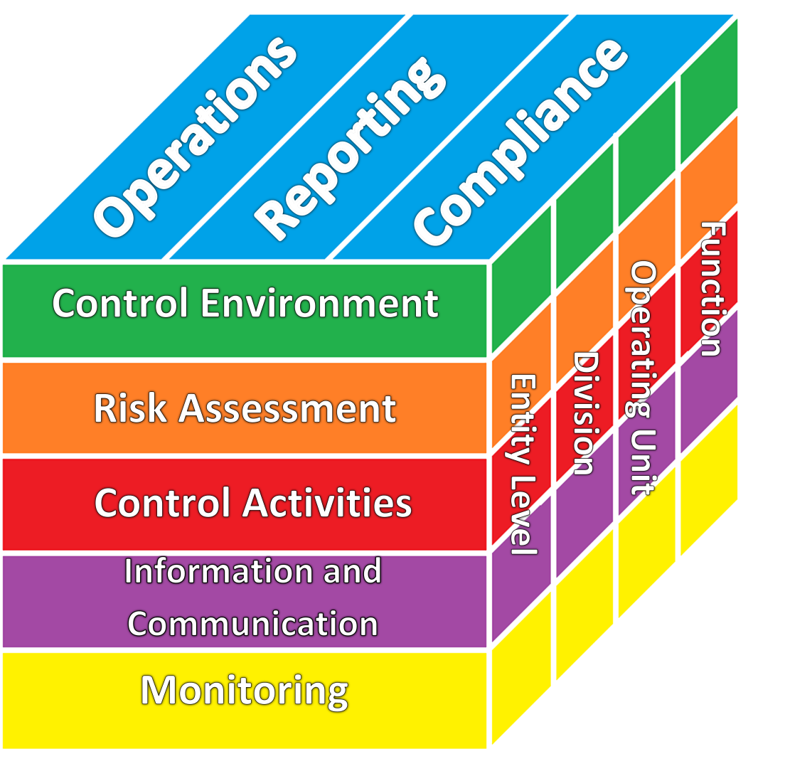
5 Components of Internal Control
Control Environment – policies & procedures, overall tone from management.
Risk Assessment – identify the things that keep you from accomplishing your objectives.
Control Activities – approvals, reconciliations, segregation of duties, etc.
Information & Communication – use relevant information and communicate appropriately.
Monitoring – How are you doing? Is the process working?

Slide 28
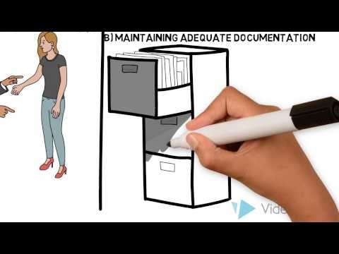
Video: Internal Controls
https://www.youtube.com/watch?v=UsF-VGxMeuQ&feature=youtu.be

Slide 29
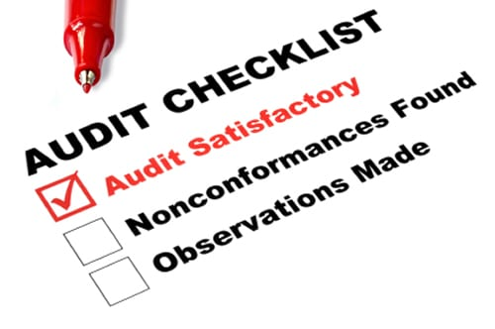
When Internal Audit Visits

Slide 30
Internal Audit will:
Schedule an entrance meeting with the Director of the unit being audited
Meet with relevant personnel to discuss an overview of processes
Brainstorm risks and discusses any concerns
Request a list of items needed for review, based on the nature of the audit
Establish a timeline for the audit – typically 6 to 8 weeks

Slide 31
Internal Audit will (continued):
Throughout the audit, we will provide bi-weekly updates
Ask questions continuously
Prepare a preliminary list of findings/observations (if applicable) for discussion
Request a response from management for any audit findings (if applicable) to be included in the final report
Issue the final report
Follow up on any findings until corrective actions are complete

Slide 32
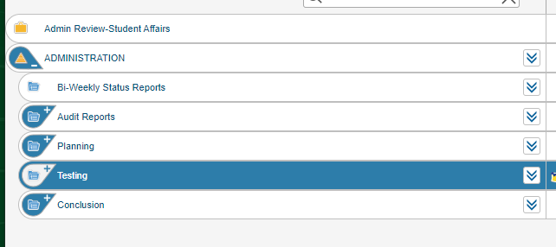
Audit Process

Slide 33
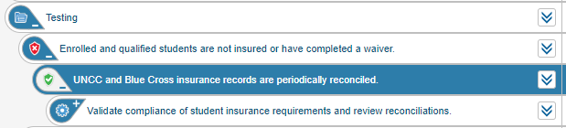
Risks, Controls, and Tests

Slide 34

Issues and Recommendations
Issue types:
Verbal – only discussed with process owner(s)
Observation
Finding
Findings and observations will be included in the audit report.

Slide 35
Common audit issues
Purchasing Card violations
Incorrect fund and/or account numbers
No asset tracking for assets under $5,000
No reconciliation of Banner to internal records
Lack of system access reviews
Outdated policies or procedures

Slide 36
Let’s test your knowledge!

Slide 37
In which Department/Division is Internal Audit located:
Business Affairs
Chancellors Office
Institutional Integrity
Finance

Slide 38
To whom does IA report it’s Findings to:
The Governor of North Carolina
CFO
The Press/Social Media
The UNCC Board (ACERM Committee)

Slide 39
T or F- Internal Audit has the right to gain access to any and all documents/information at UNC Charlotte:
TRUE
FALSE

Slide 40
What is Internal Audit’s Purpose/Objective:
To get people fired.
To inflict pain and torment.
Ensure Charlotte is run efficiently, effectively, and is in compliance with NC statutes.
All of the Above.

Slide 41
Who is responsible for establishing/implementing controls?
The Chancellor
Business Units
Board of Trustees
Internal Audit

Slide 42
Which funds should you reconcile routinely?
A. The one you used last
B. All assigned funds
C. Only the petty cash fund
D. The monthly phone bill

Slide 43
Control activities can be defined as:
A. Means to an end
Authorized procedures
The particular category in which a control is placed
Steps within a process designed to provide reasonable assurance regarding the achievement of your objectives

Slide 44
Which of the following is an Internal Control?
Segregation of Duties
Reconciliations
Authorizations
All of the Above

Slide 45
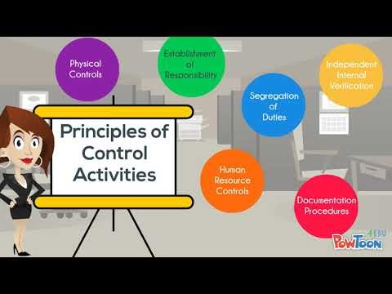
Audit Recap:

Slide 46
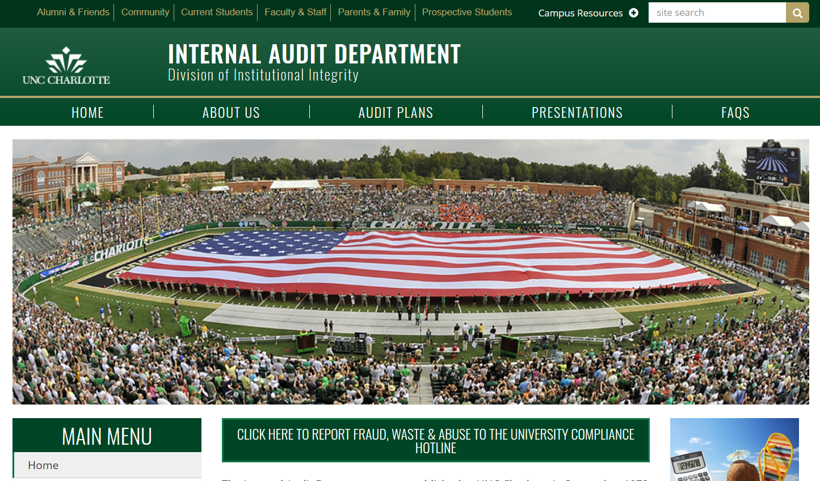
Website: https://internalaudit.charlotte.edu/

Slide 47

Additional Internal Audit Services
Evaluate and make recommendations where needed in:
  Policies and procedures
  Internal controls
  Process changes
  System development
Conduct audit education
Perform process reviews
Investigate (ethical and compliance) fraud

Slide 48


